Slide 1
VILLAGE ADMINISTRATOR’S END-OF-YEAR REPORT
2022

Slide 2
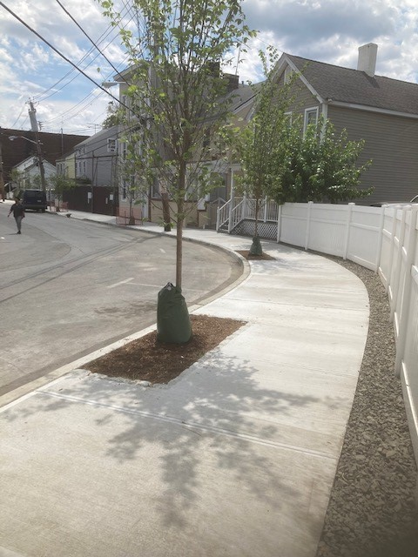
PROJECTS
STREETS AND SIDEWALKS
Clinton Avenue Sidewalk Project
Beekman Avenue Sidewalks/Traffic Signal
WATER AND SEWER
Route 9 Culvert Repair
North Washington Drainage Project
ENVIRONMENT
Devries Park/Pocantico River
Fremont Pond Restoration Project
LOCAL DEVELOPMENT CORPORATION
Viaduct Removal
DPW Garage Design

Slide 3
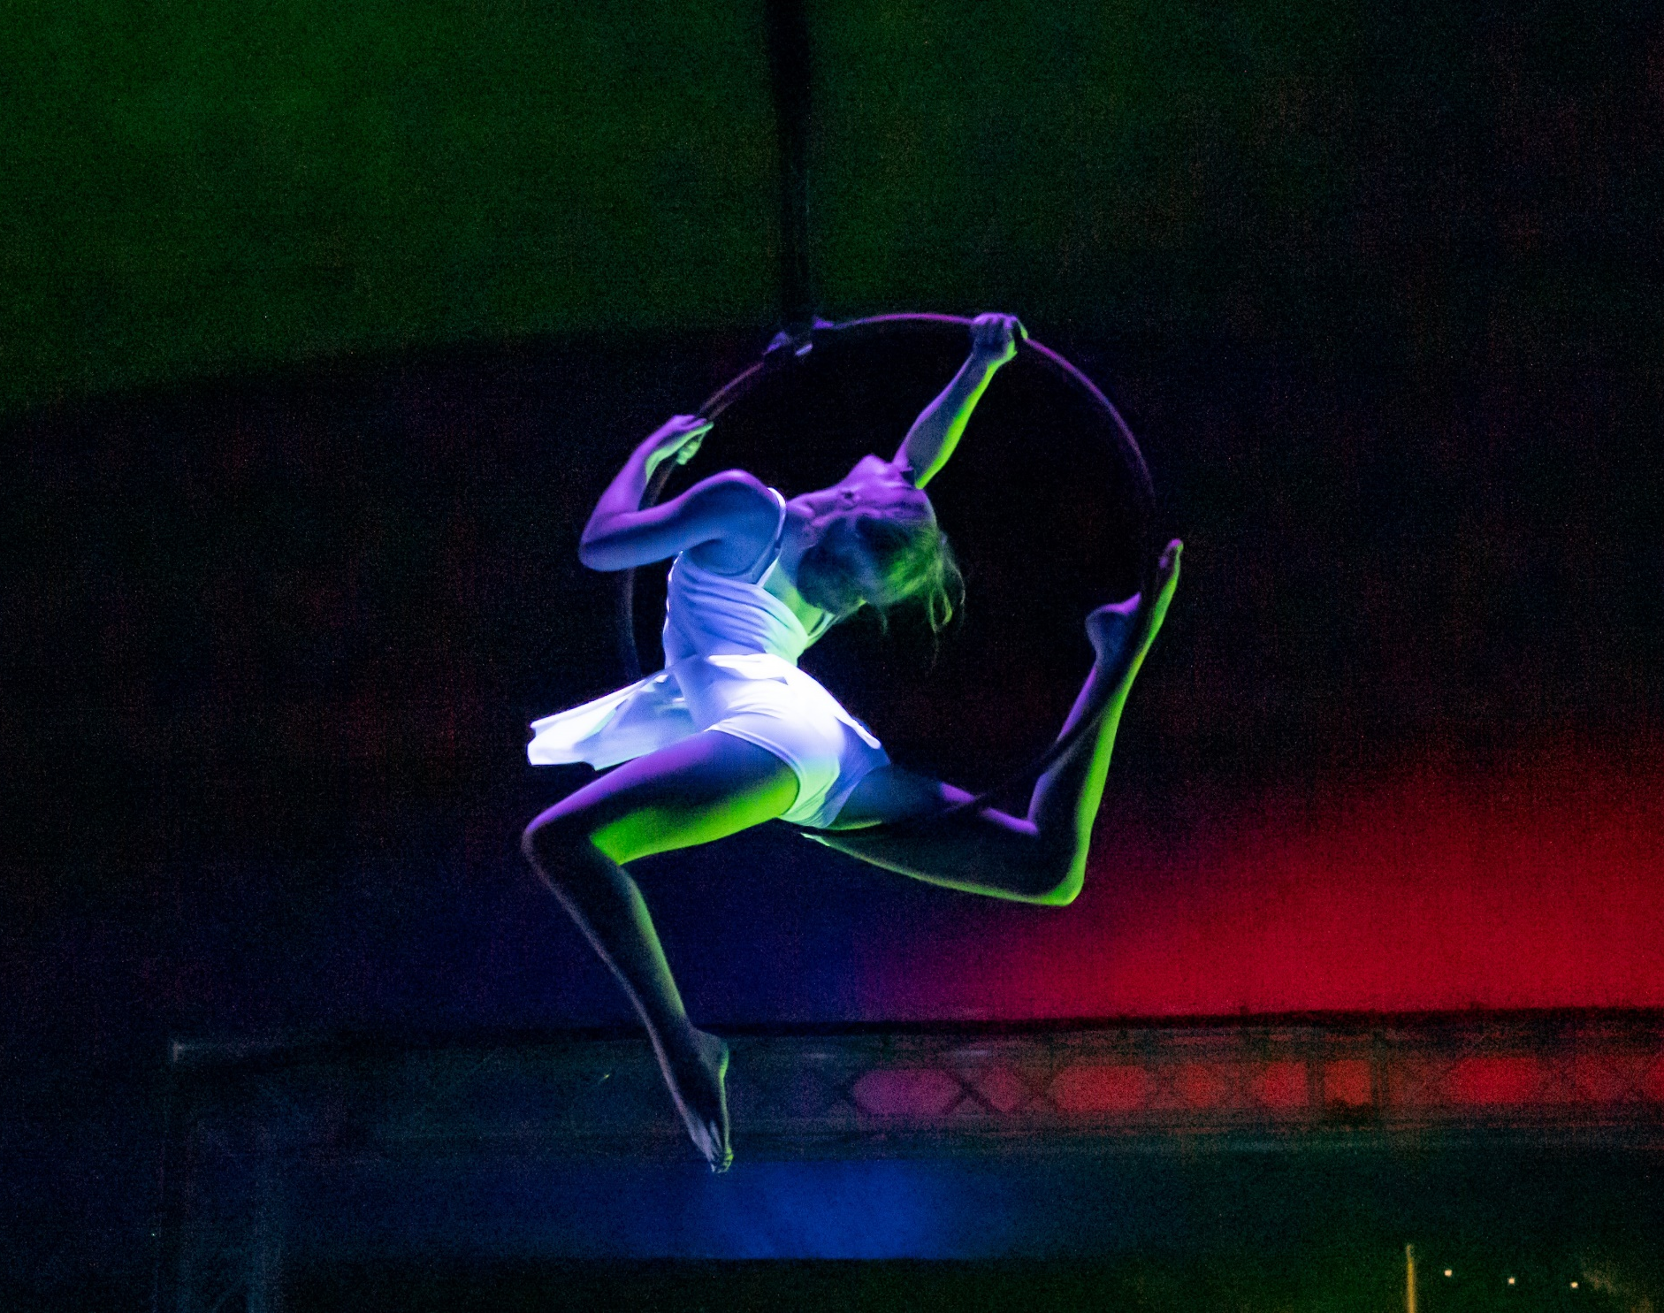
GRANTS
Economic Development
Recently Completed $160,000 (Washington Irving themed circus)
Awarded/On-Going $145,000 (For Music Festival and Planning)
Pending - $15,000,000 (DRI, NY Forward, Restore New York)
Connectivity
Recently Completed - $1,131,000 (Beekman and Clinton Sidewalks)
Awarded/On-Going - $490,000 (Sidewalks and Riverwalk Design)
Parks and Open Space
Awarded/On-Going - $1,360,000 (Devries, Skatepark, Plaza)
Water and Sewer
Awarded/On-Going - $1,651,166 (Pipe Re-lining, Storm Water)
Sustainability
Awarded/On-Going - $443,141 (Climate Smart, Fremont Pond)
Local Development Corporation
Awarded/On-Going $5,580,000 (Common and DPW Garage)

Slide 4
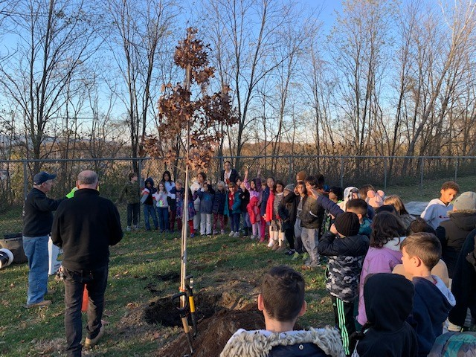
LOCAL LAWS AND POLICIES
LOCAL LAWS
Tree Ordinance - The Village Board updated the tree code to improve the Village’s tree management program.
Affordable Housing - The Village Board adopted an affordable housing policy for the 61 affordable units located at Edge-on-Hudson. Most of the 61 units have been filled.
Downtown Zoning Amendment - The Village Board amended downtown zoning.
POLICIES
Solar Energy - A sub-committee of the Village Board was formed to work on a solar energy initiative with the Elm St. lot and new DPW garage as potential solar pVillage Board was formed to identify crosswalks that are in need ower locations.
Crosswalks - A sub-committee of the upgrades with the goal of improving pedestrian safety.
Traffic Mitigation – Traffic Calming devises were installed at various locations.
Edge Dedication - The Village Board considered accepting the dedication of parks, streets, sidewalks and utilities from Edge-on Hudson.
One Pleasant Street - The Village purchased a home at One Pleasant Street for the purpose of widening Continental Street to create two-way traffic.

Slide 5
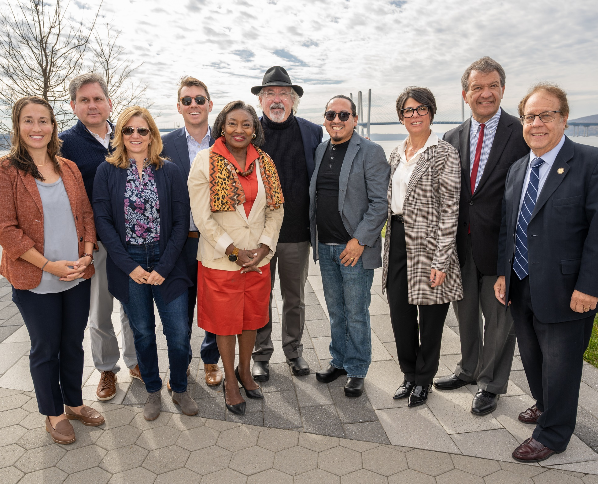
COMMUNICATIONS
Communications Director - The new communications director started in September enabling Village to better inform the public regarding Village business.
Community Liaison – The Community Liaison has organized several outreach events and programs.
Website Upgrades - The Village has been working to improve its website in an effort to make it more user friendly.
Promotional Video - The Village Board engaged CGI Communications to create a promotional video for the Village.
Tourism App - Sleepy Hollow, Tarrytown and Irvington received grant for a tourism app that provides virtual tours of popular destinations within the three villages.

Slide 6
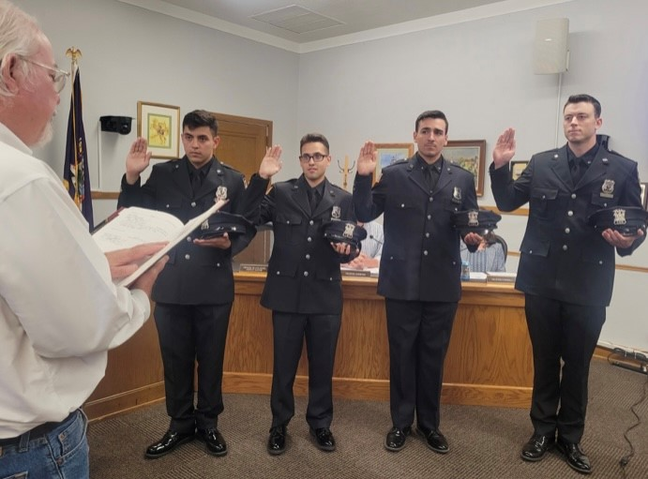
STAFFING
Assistant Building Inspector – An Assistant Building Inspector was hired to address the building department’s heavy workload including Edge-on-Hudson
Tree Officer - The Village retained a certified arborist to review both private tree removal permits and public tree removal to improve the Village’s tree management program.
Deputy Treasurer - The Village hired a deputy treasurer to prepare for the large growth of the Village.
DPW/Parks - Additional staff was hired in both the Department of Public Works and Parks Department. A new Assistant General Foreman Position was created and filled.
Communications Director - The Village Board created a communications director position in an effort to improve transparency and to keep the public informed on Village business.
Police – 4 new police officers came on the Board at the beginning of the year and the department saw changes to key positions.

Slide 7
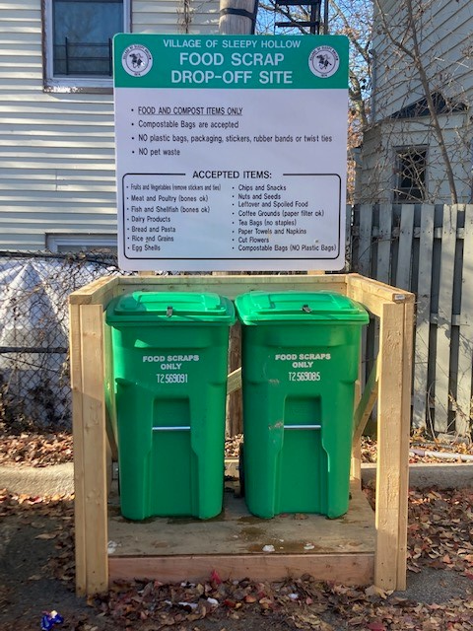
ENVIRONMENT
Climate Smart Task Force - The Village’s Climate Smart Task Force has been working hard to achieve goals established though the New York State Climate Smart Program.
Food Scrap Program – One Climate Smart Task Force initiative is to establish a food scrap program. Food scrap kits are available at various locations.
Heat Pumps - The Village participated in Sustainable Westchester’s heat pump program to promotes the reduction of greenhouse gas emissions and to save energy.
Westchester Power - The Village renewed its participation in the Community Choice Aggregation (CCA) Program.
Public Space Council - The Public Space Council assists the Village in the design and maintenance of public spaces. The group helped oversee the design of the new Riverwalk at Edge.
Tree Committee - An ad-hoc tree committee was formed to create a tree management program. The committee has members from the Public Space Council, Planning Board and Tree Commission.
Pollinator Gardens - Volunteers have planted several pollinator gardens throughout the Village.

Slide 8
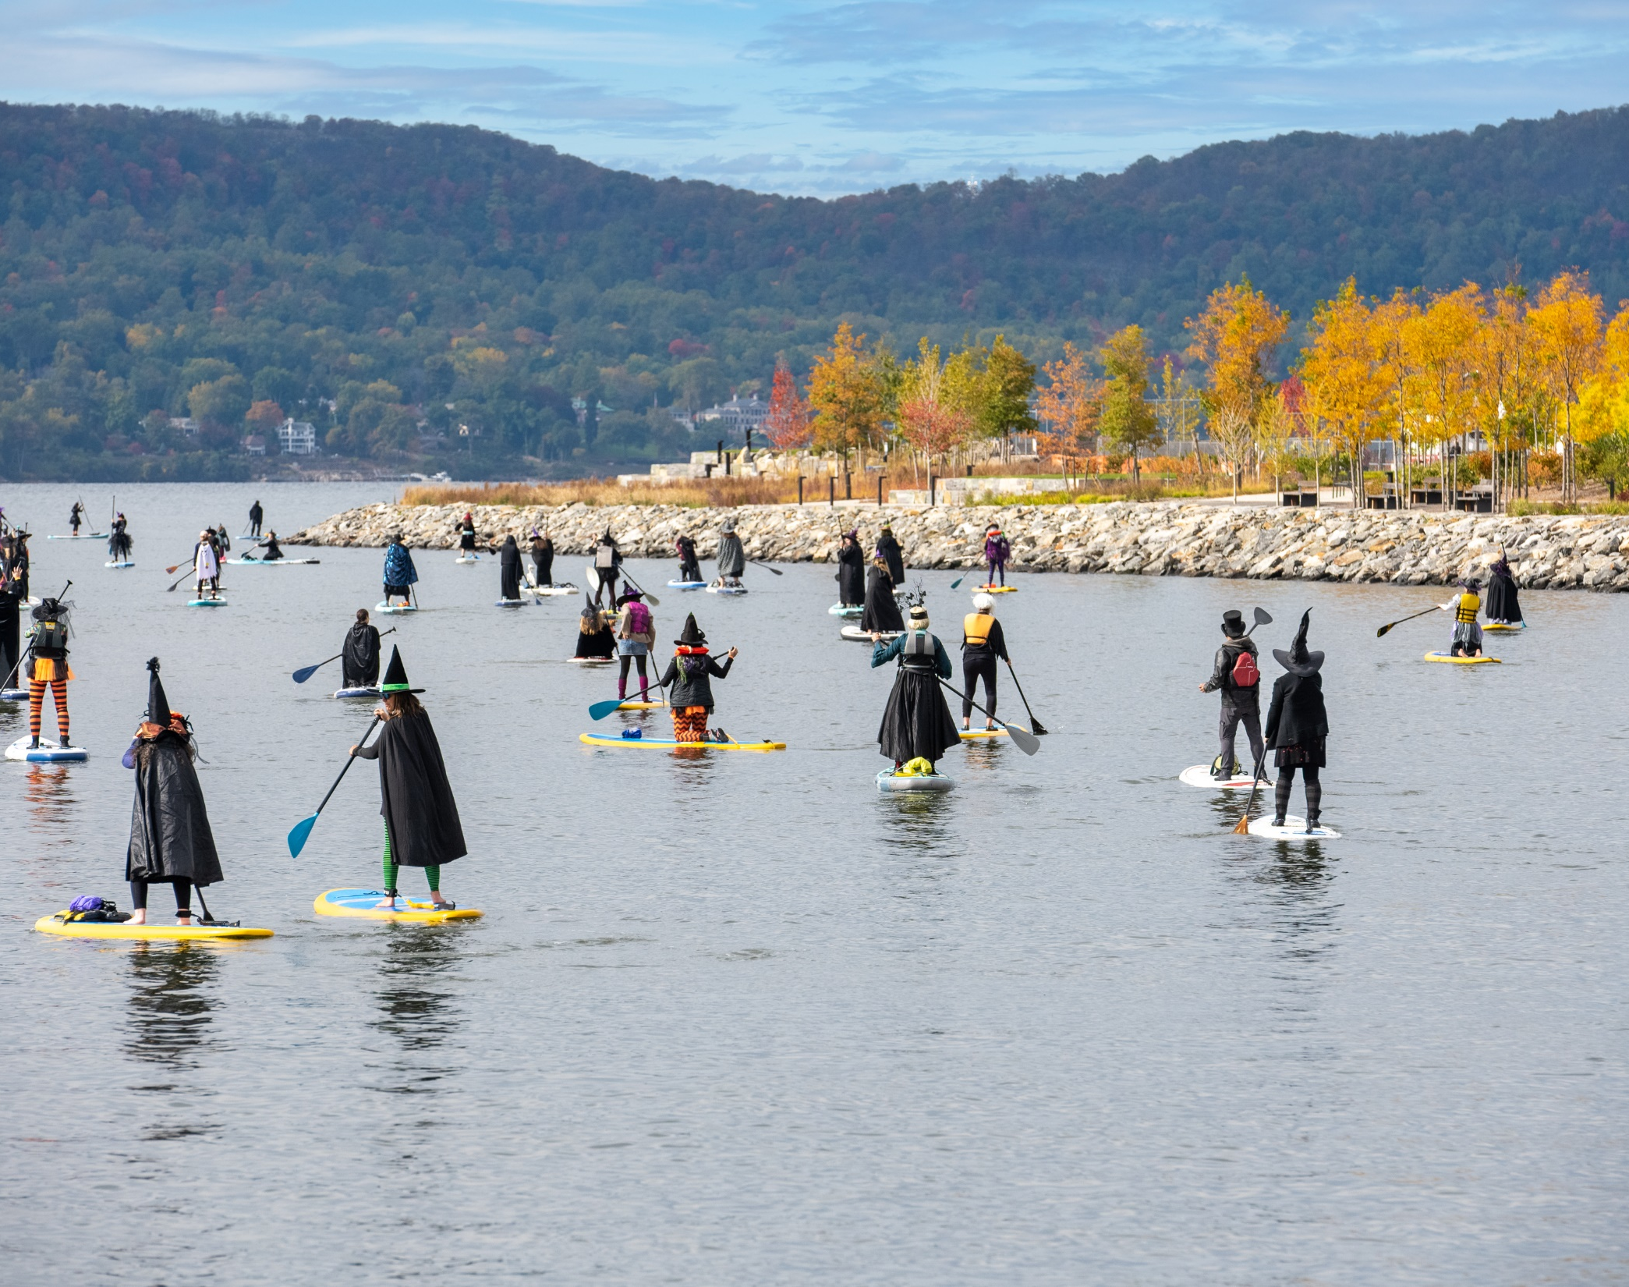
EVENTS
MARCH - St Patrick’s Parade, Half Marathon
MAY - Memorial Day Parade
JUNE - Sleepy Hollow Sprint Triathlon
JULY - Fourth of July Fireworks
AUGUST - Ecuadorian Festival
SEPTEMBER - Doylefest, Cultural Festival, Oktoberfest, The Legend Circus
OCTOBER - Emergency Services Day, Street Fair, Film Festival, Glass Pumpkins, SUP Witches, 10k Run, Hayride and Block Party.
DECEMBER - Tree Lighting, Winter Stroll
Additional events have been organized by the Recreation Department, Community Liaison, Fire Department and the PBA,

Slide 9
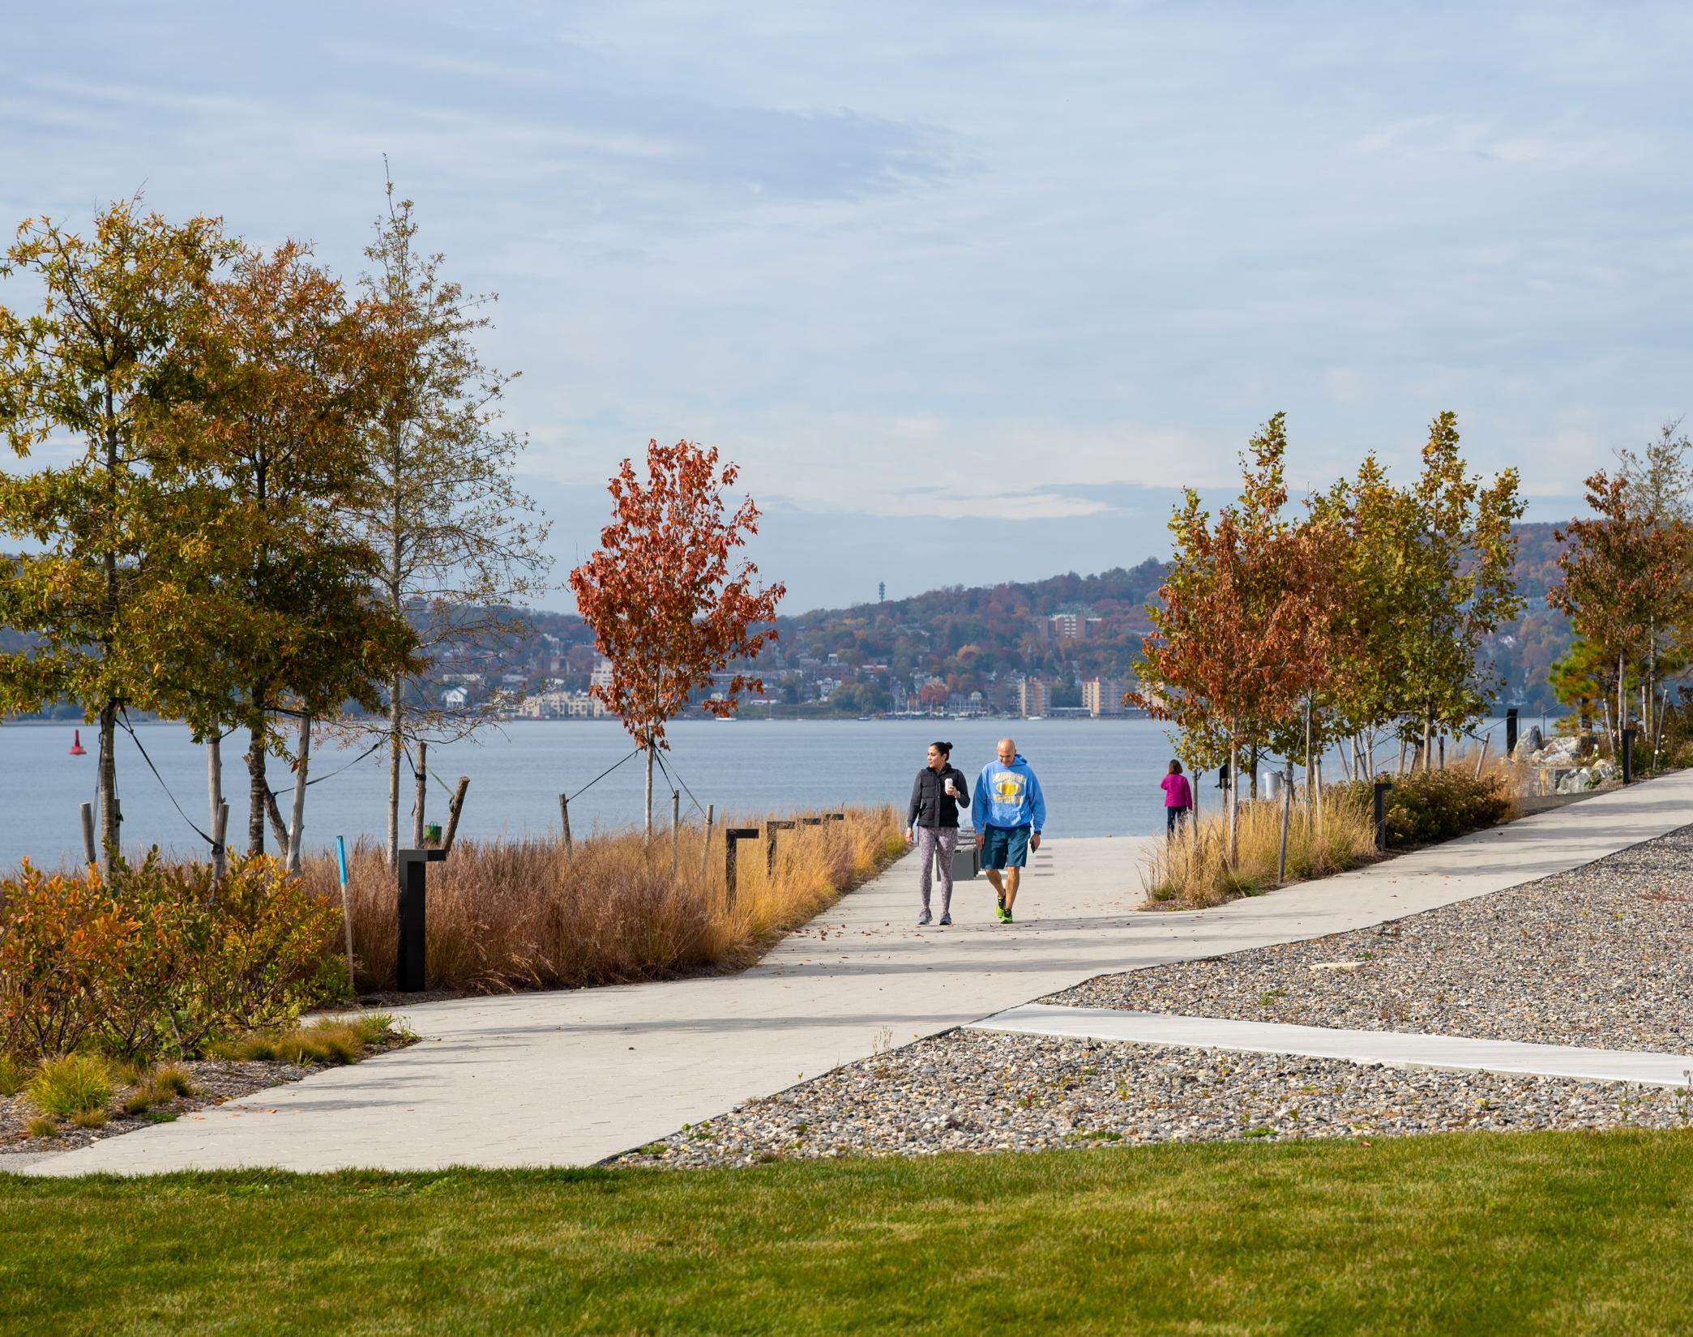
PARKS
New Riverwalk - Formally dedicated to the Village on October 31.
Sykes Park - New playground and resurfacing
Devries Park - Platform Tennis Courts Heating System
Kingsland Point Park - New outdoor fitness equipment
Barnhardt Park - Spray Ground Resurfacing and Basketball Court Resurfacing
Horan’s Landing - Kayak Rack and Gold Start Mother’s Statue at Horan’s Landing
Margotta Courts - Basketball Court Resurfacing
Douglas Park - New Playground

Slide 10
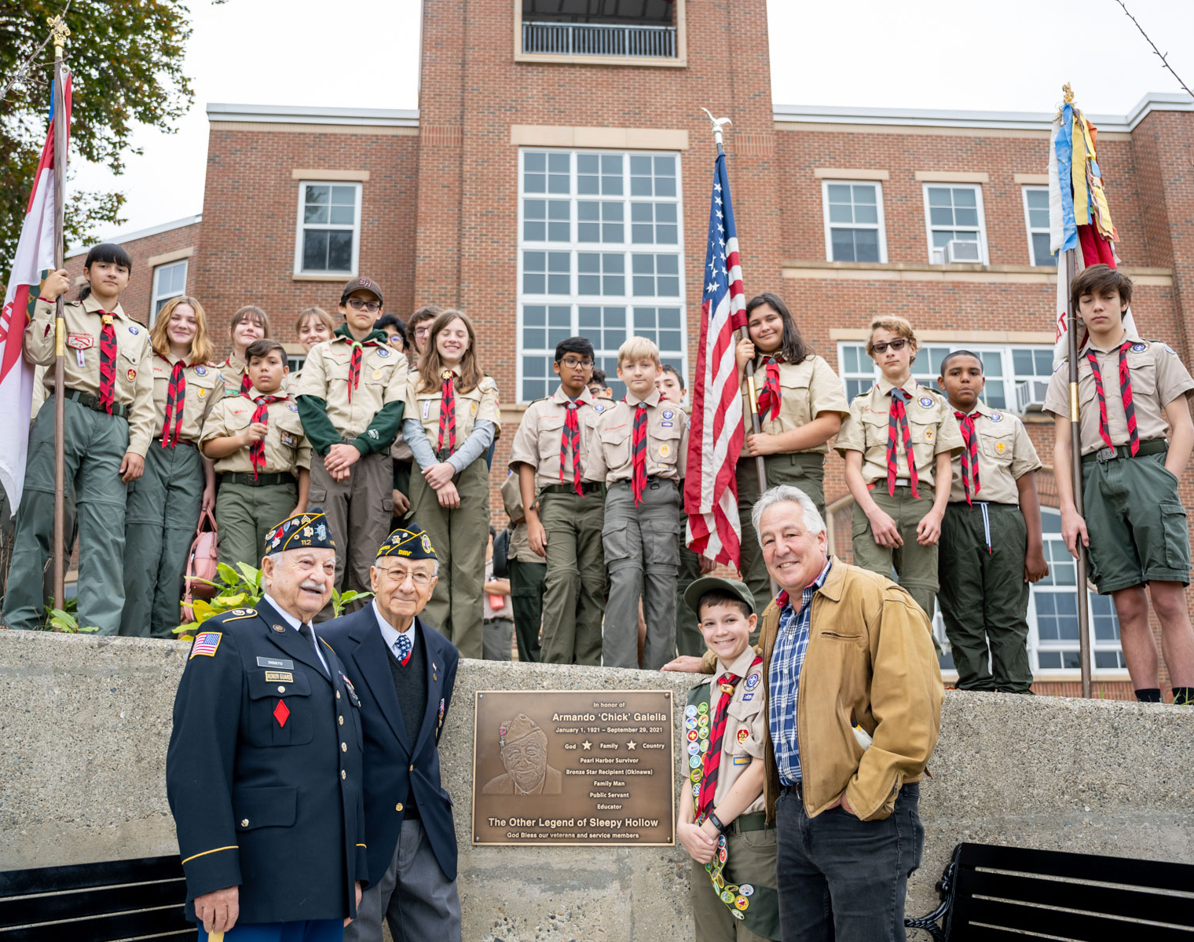
OTHER
Sleepy Hollow Lighthouse - A $3.4 million project to restore the historic lighthouse to be complete in the summer of 2023.
Kingsland Point Park Seawall - A two year $6 million project to restore the entire seawall at Kingsland Point Park.
Chick Galella Memorial - Spearheaded by Boy Scout Dylan Smith with assistance from Sleepy Hollow, Tarrytown and the School District.

Slide 11
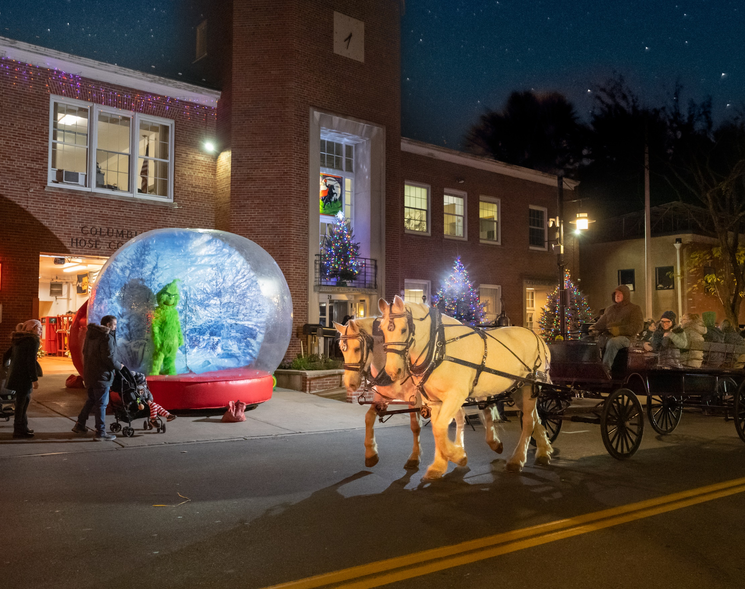
HAPPY HOLIDAYS

